Slide 1
Cause Of Death Presentation by-Nandini Singh

Slide 2
Cause Of Death - A straightforward way to assess the health status of a population is to focus on mortality – or concepts like child mortality or life expectancy, which are based on mortality estimates. A focus on mortality, however, does not take into account that the burden of diseases is not only that they kill people, but that they cause suffering to people who live with them. Assessing health outcomes by both mortality and morbidity (the prevalent diseases) provides a more encompassing view on health outcomes. This is the topic of this entry. The sum of mortality and morbidity is referred to as the ‘burden of disease’ and can be measured by a metric called ‘Disability Adjusted Life Years‘ (DALYs). DALYs are measuring lost health and are a standardized metric that allow for direct comparisons of disease burdens of different diseases across countries, between different populations, and over time. Conceptually, one DALY is the equivalent of losing one year in good health because of either premature death or disease or disability. One DALY represents one lost year of healthy life. The first ‘Global Burden of Disease’ (GBD) was GBD 1990 and the DALY metric was prominently featured in the World Bank’s 1993 World Development Report. Today it is published by both the researchers at the Institute of Health Metrics and Evaluation (IHME) and the ‘Disease Burden Unit’ at the World Health Organization (WHO), which was created in 1998. The IHME continues the work that was started in the early 1990s and publishes the Global Burden of Disease study.

Slide 3
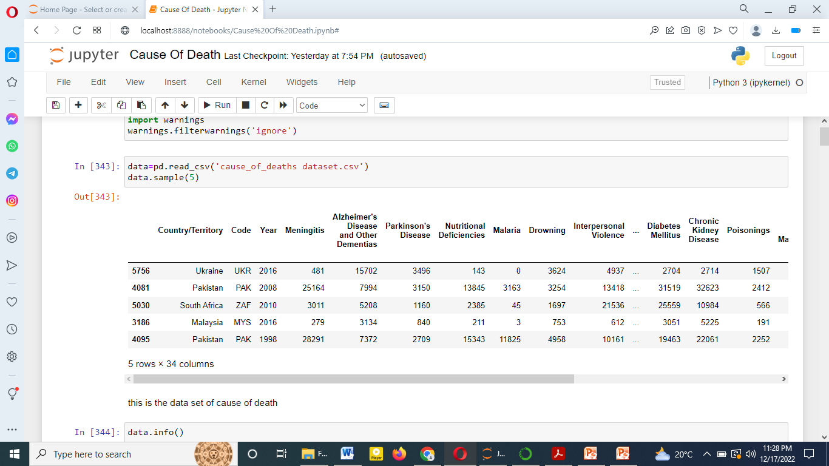

Slide 4
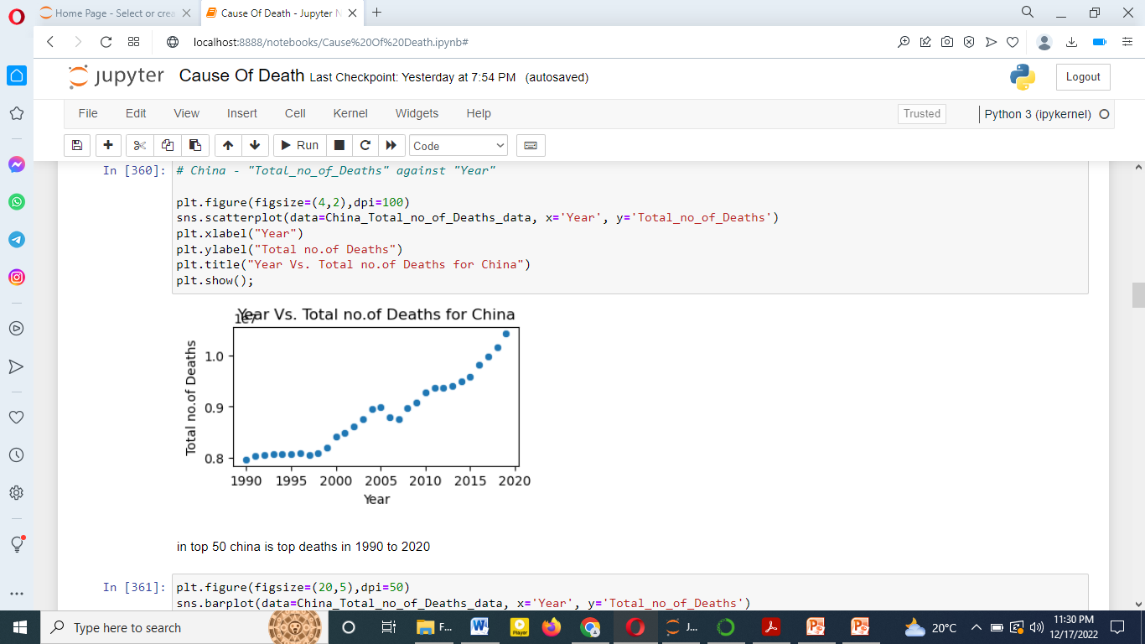

Slide 5
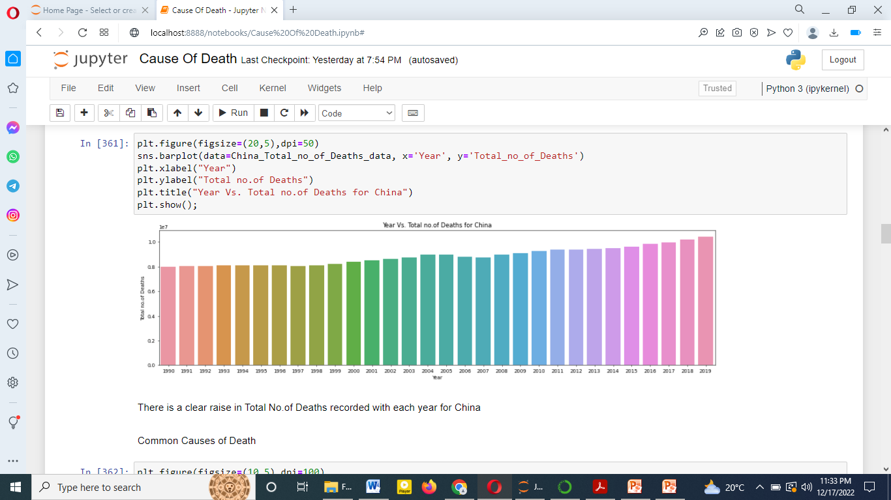

Slide 6
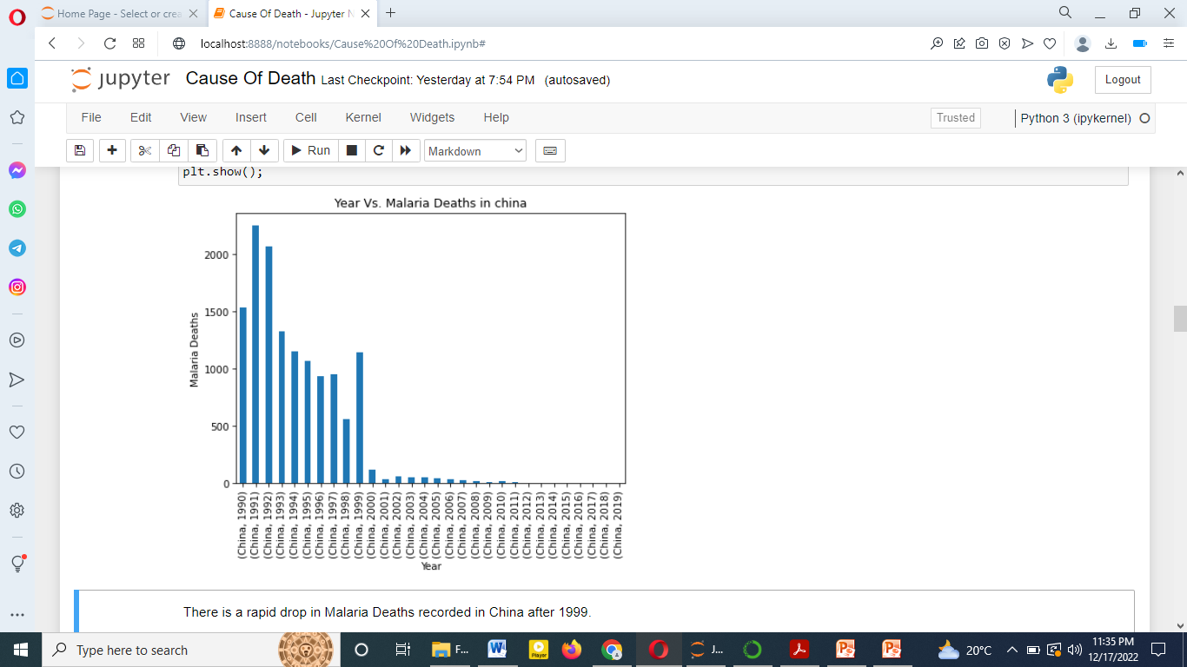

Slide 7
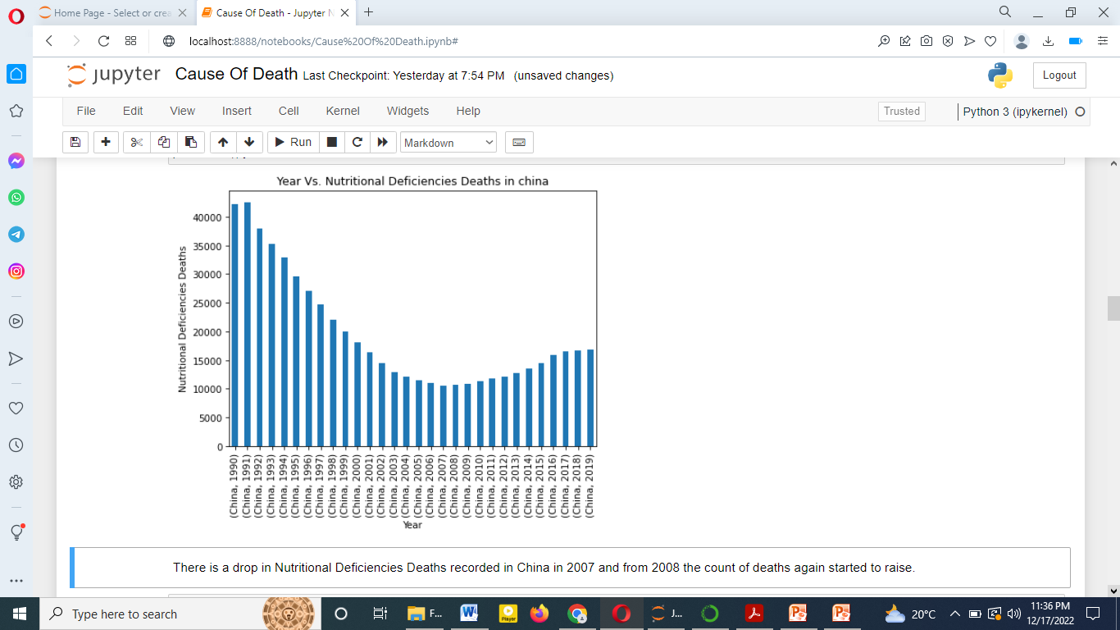

Slide 8
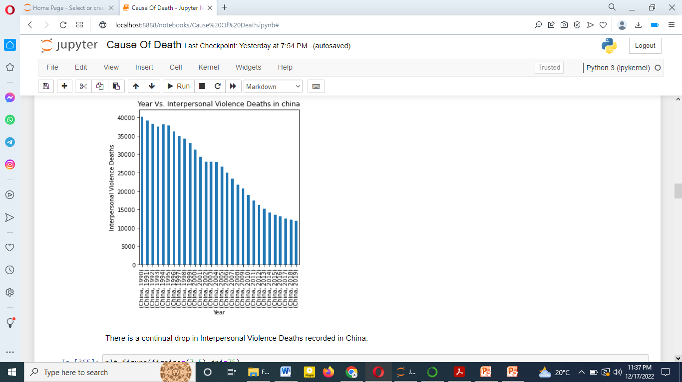

Slide 9
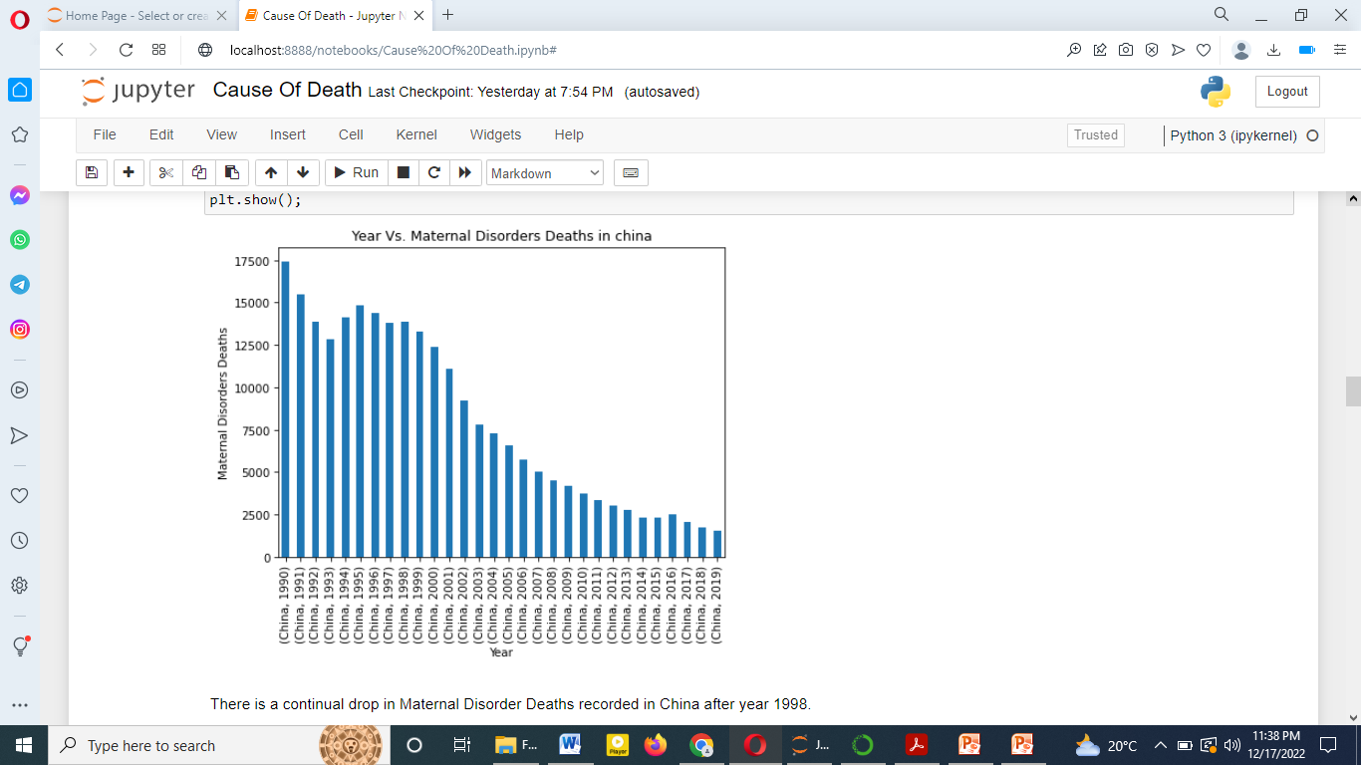

Slide 10
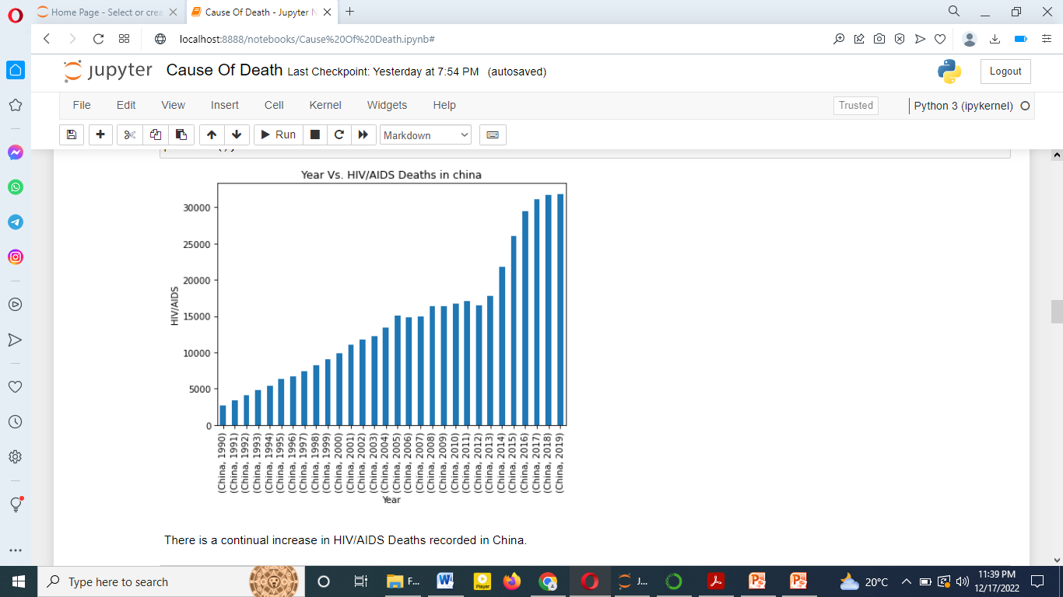

Slide 11
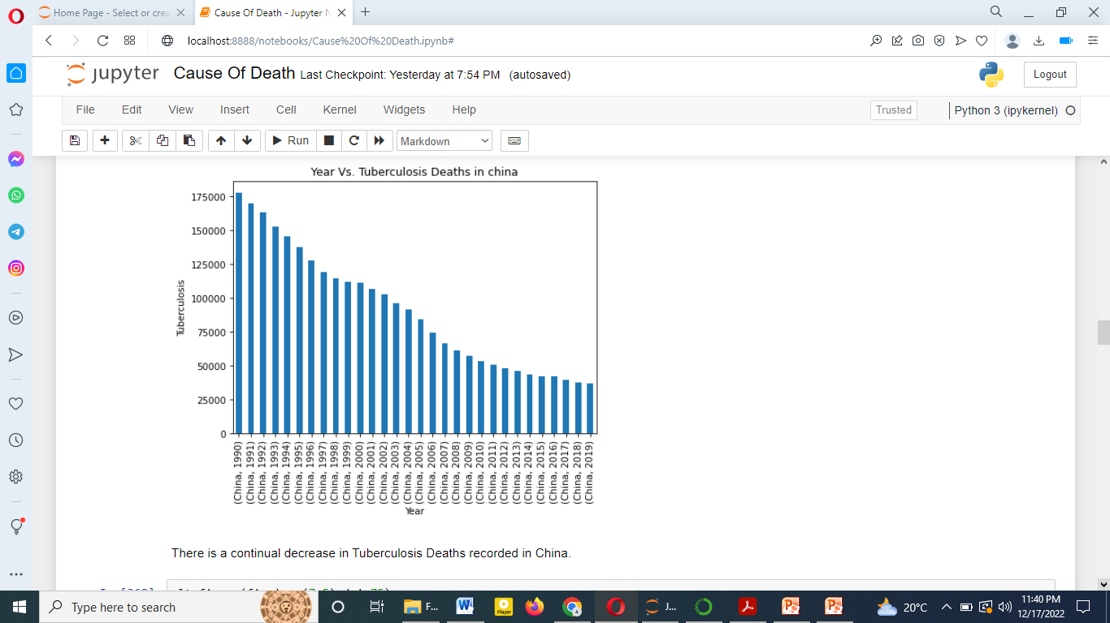

Slide 12
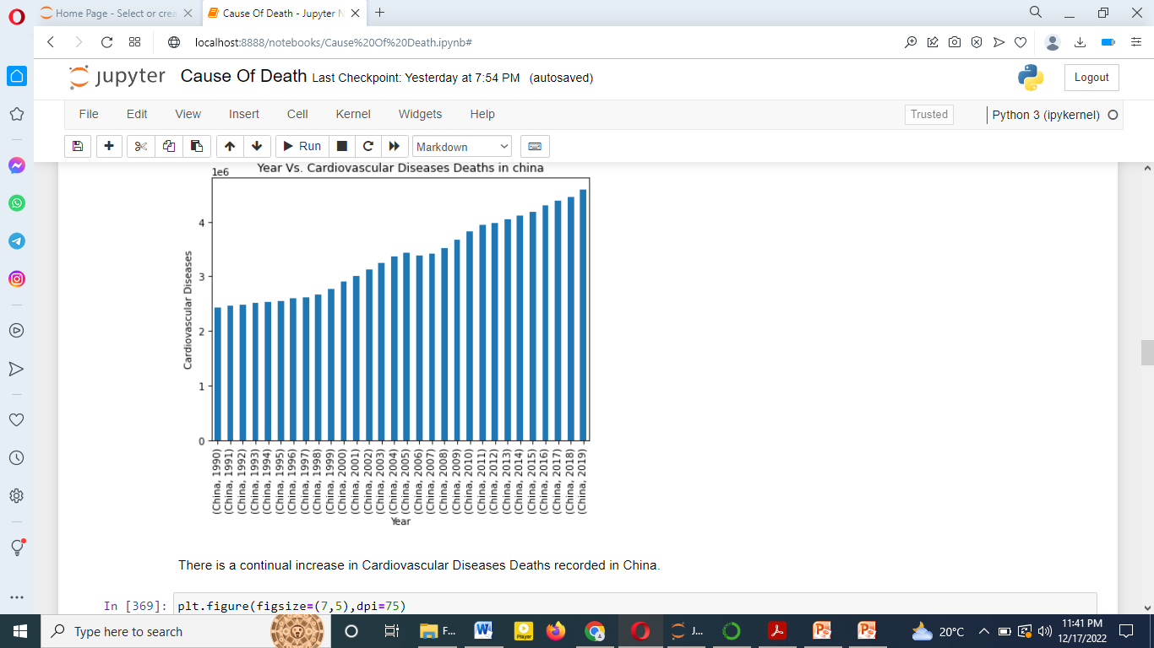

Slide 13
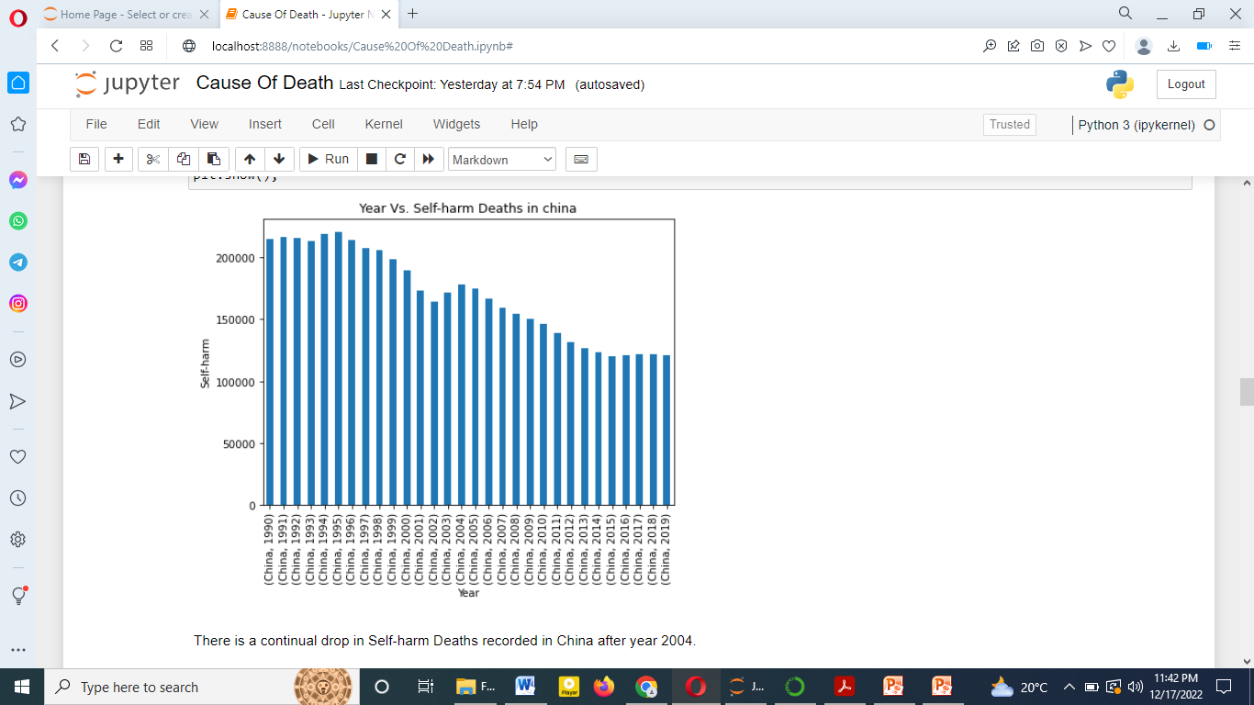

Slide 14
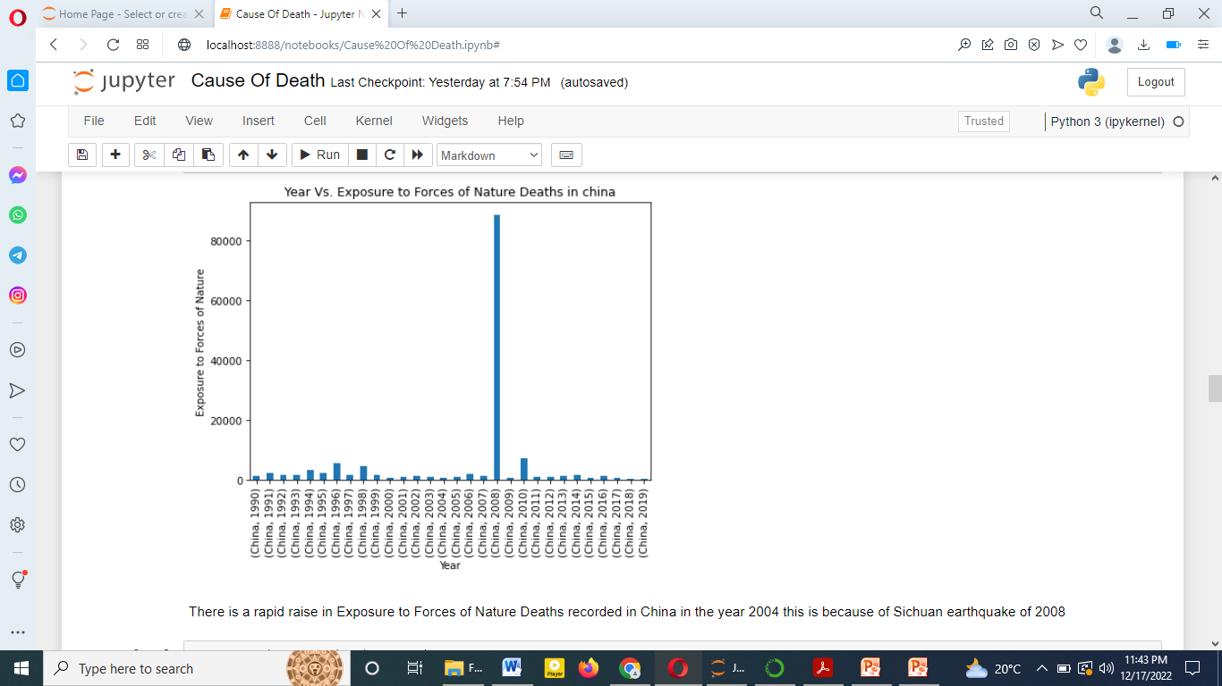

Slide 15
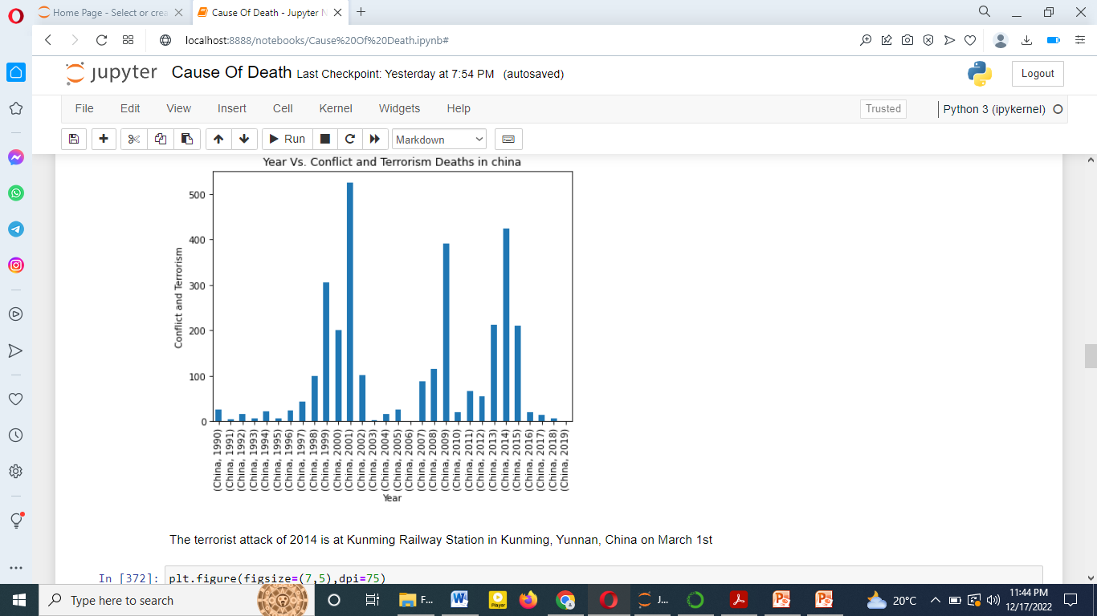

Slide 16
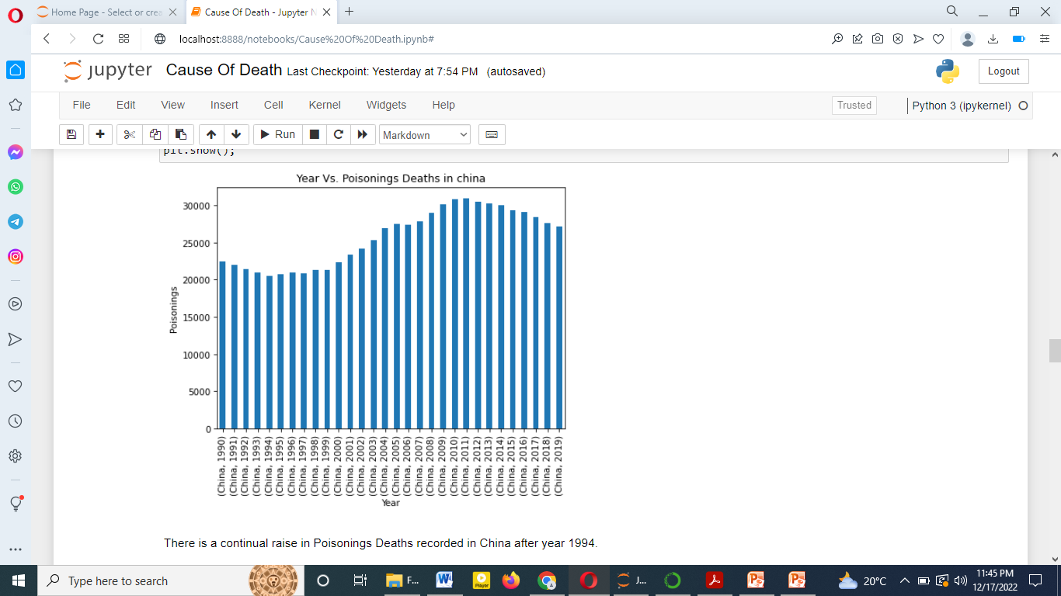

Slide 17


Slide 18
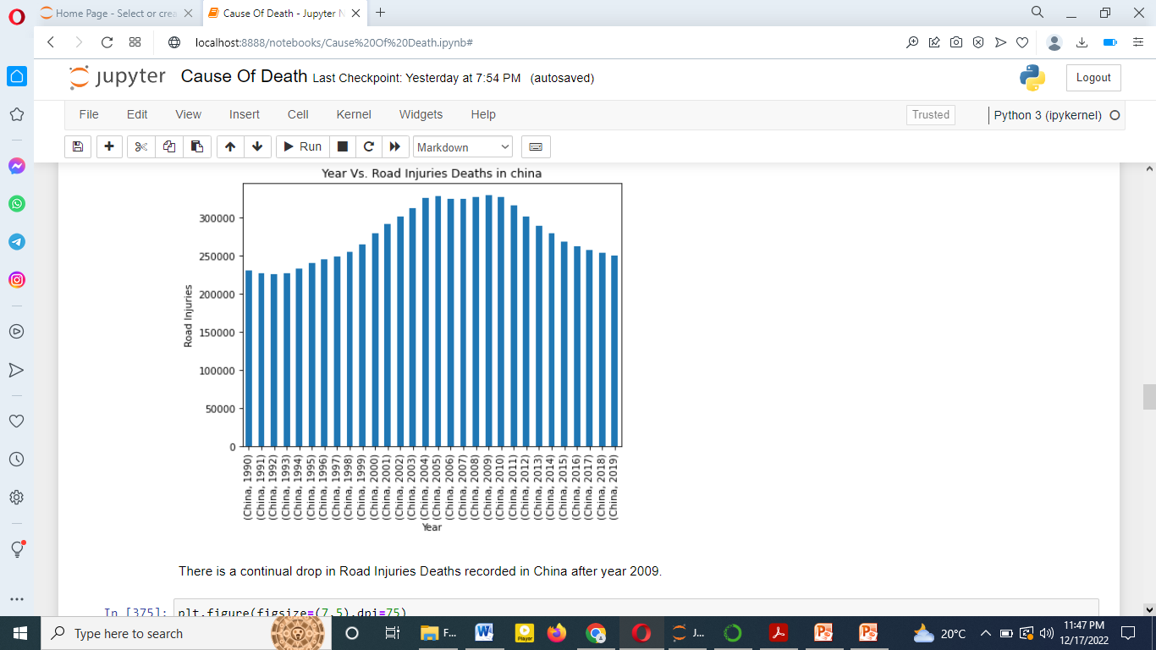

Slide 19
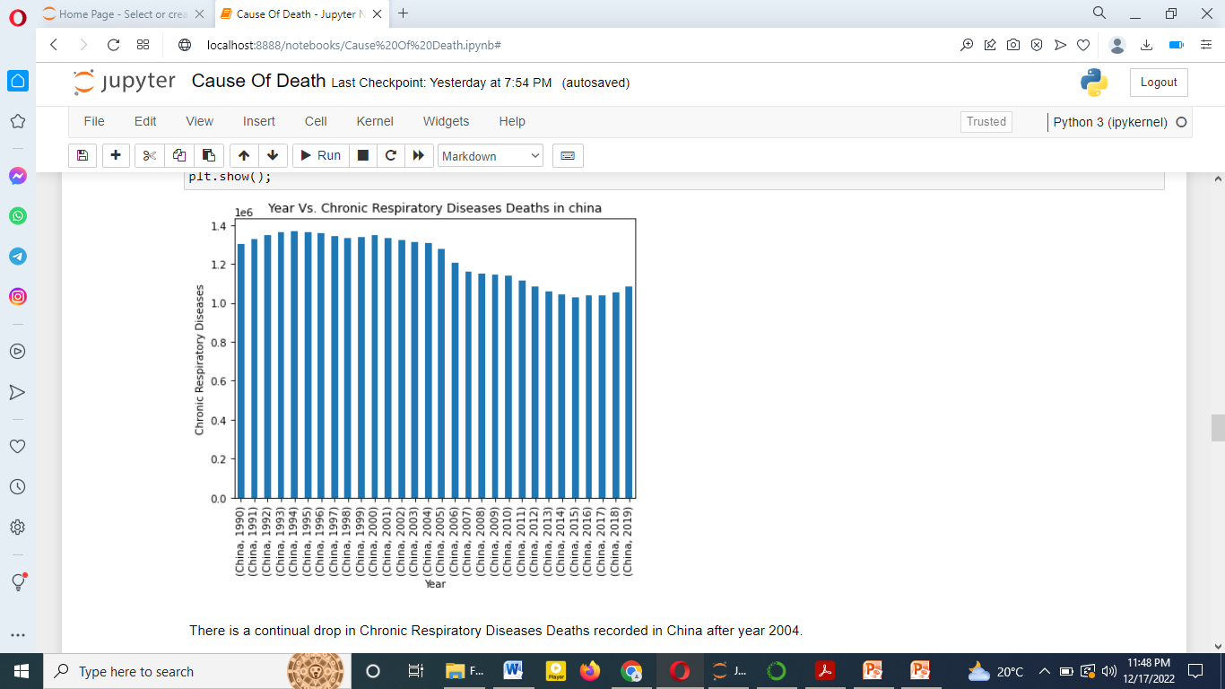

Slide 20
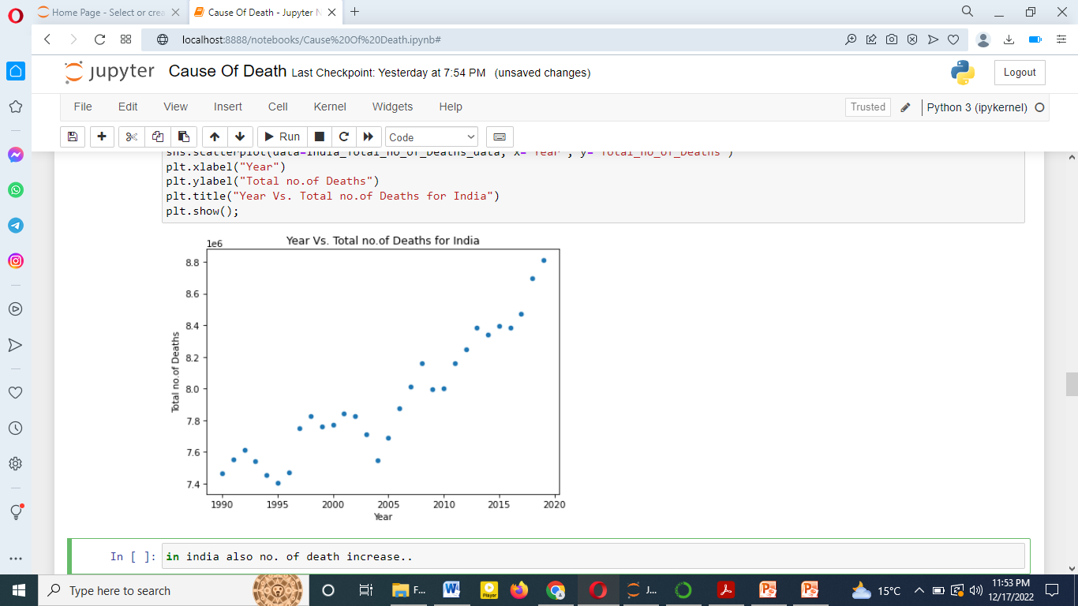

Slide 21
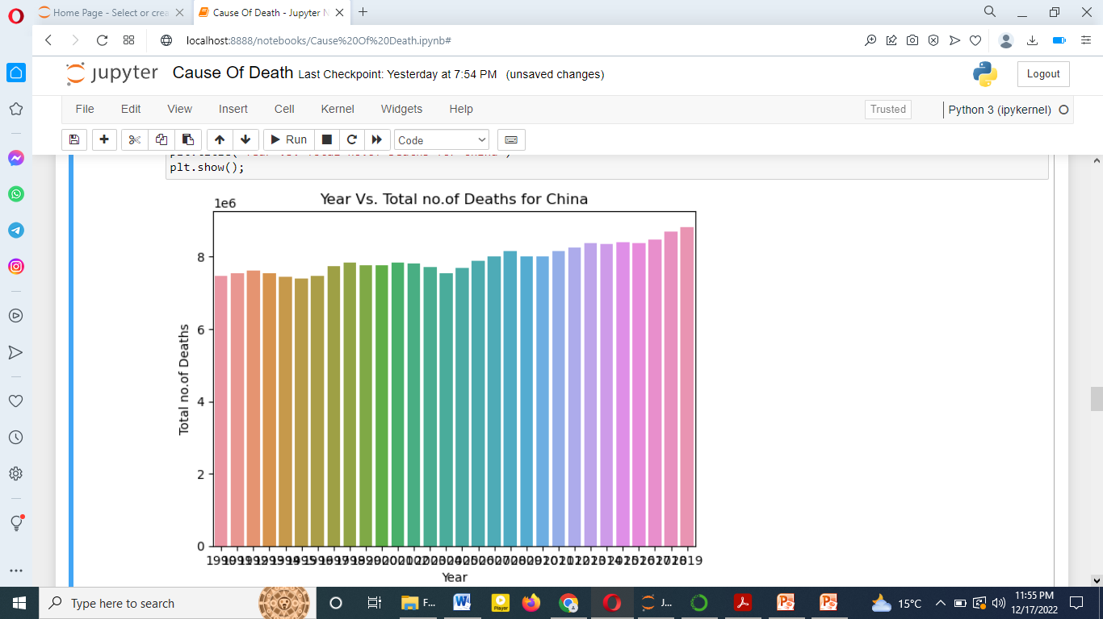

Slide 22
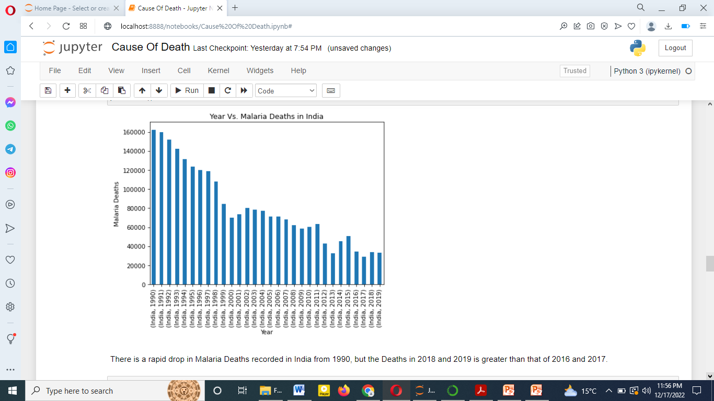

Slide 23
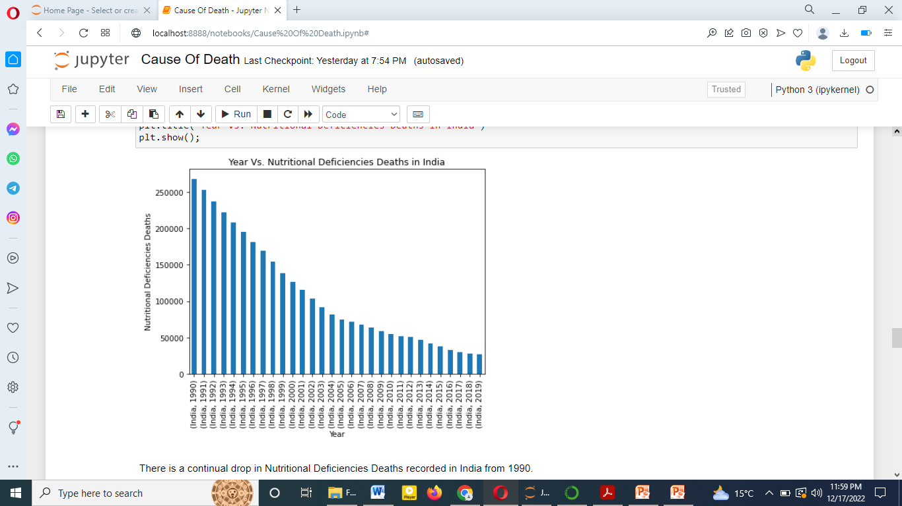

Slide 24
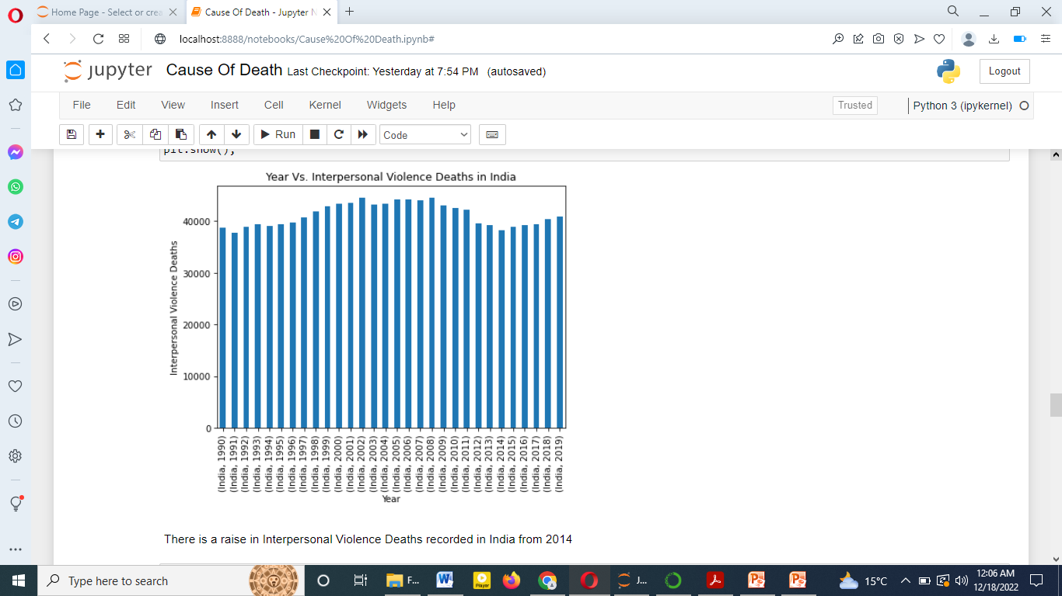

Slide 25
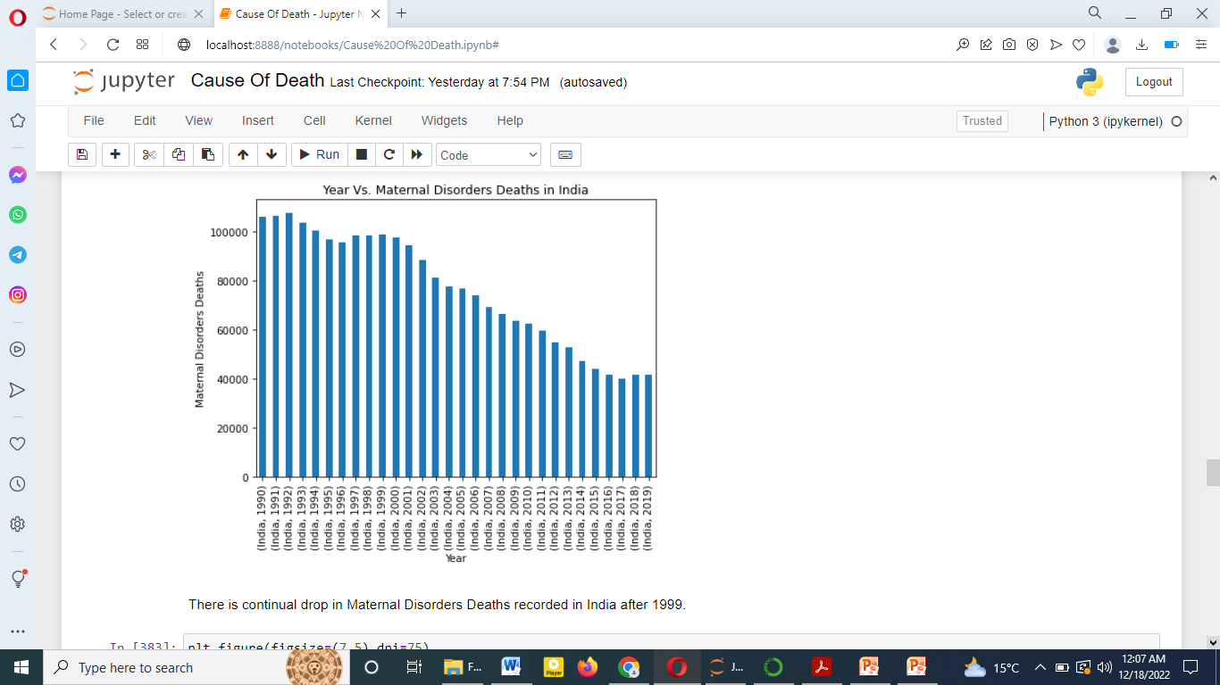

Slide 26
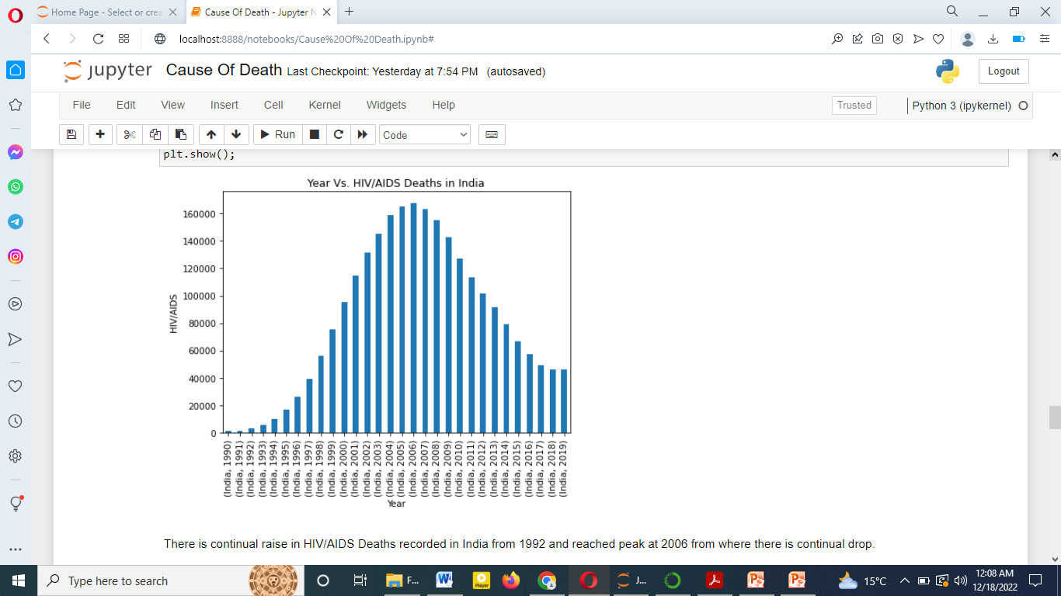

Slide 27
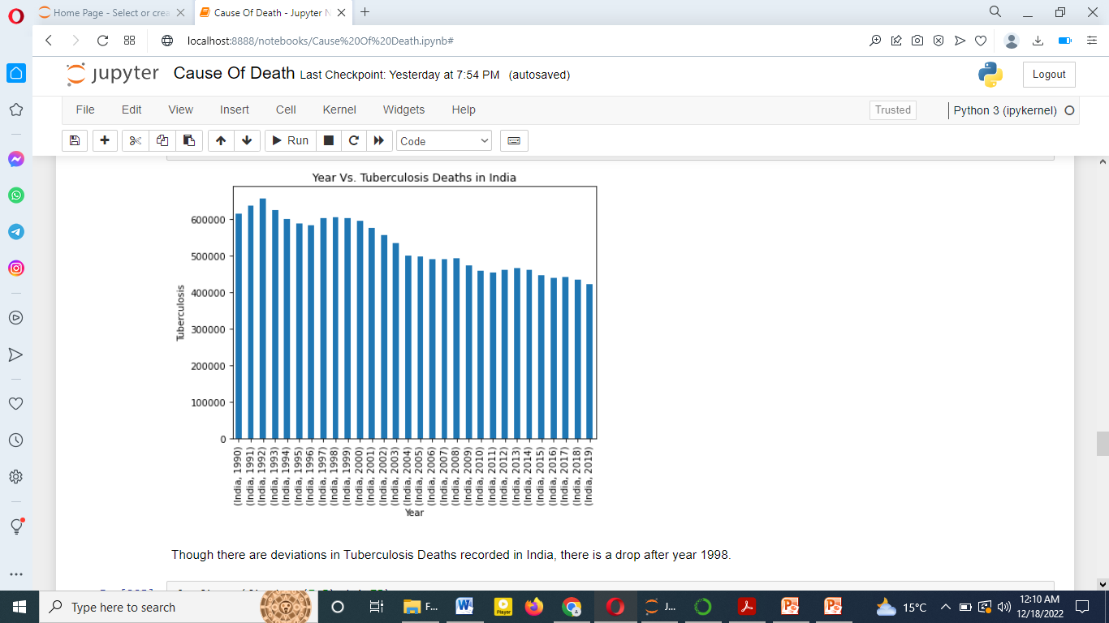

Slide 28
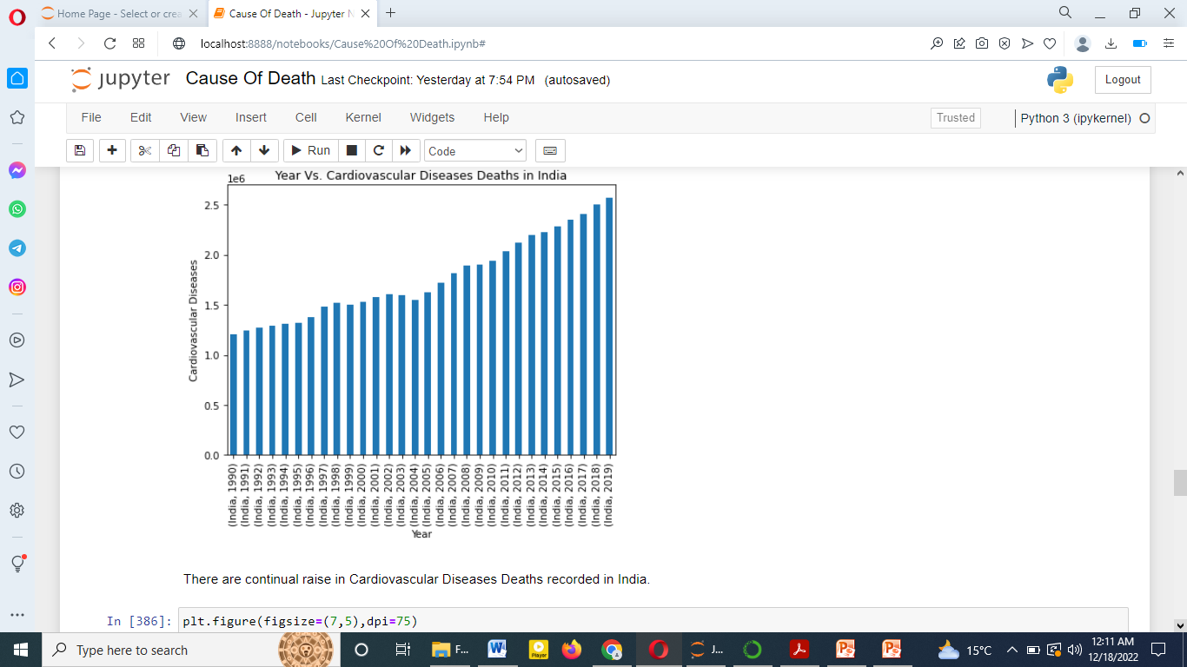

Slide 29
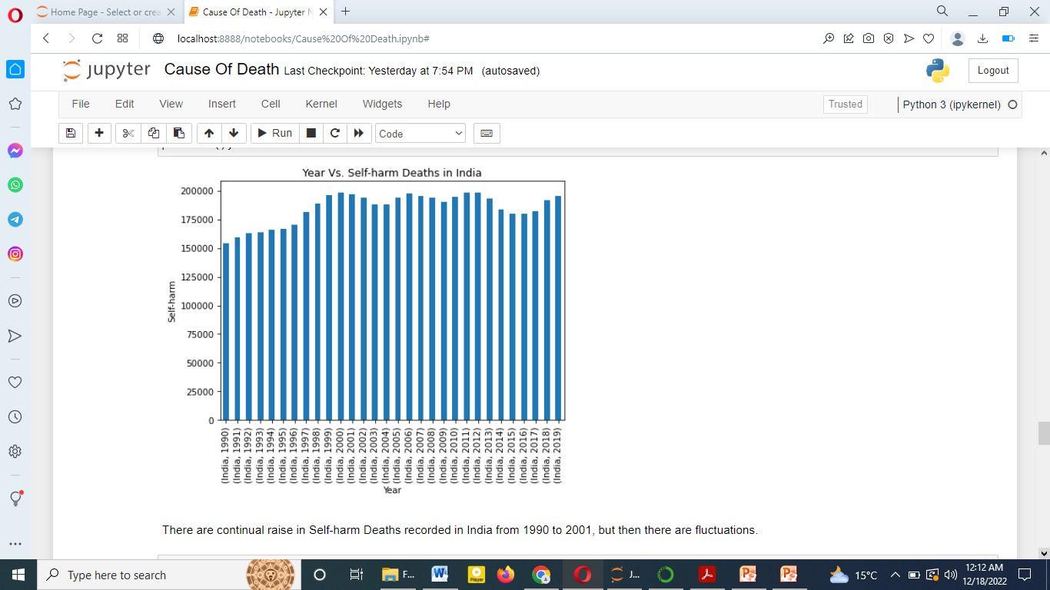

Slide 30
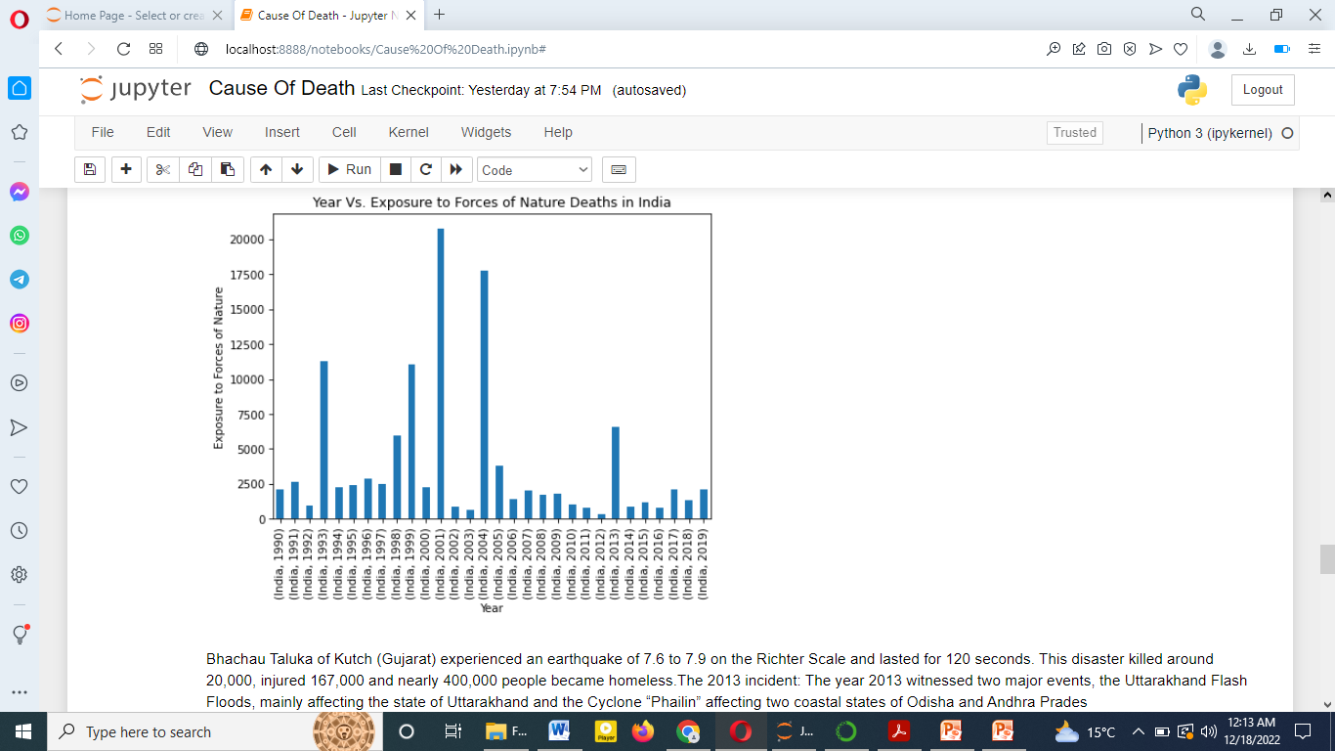

Slide 31
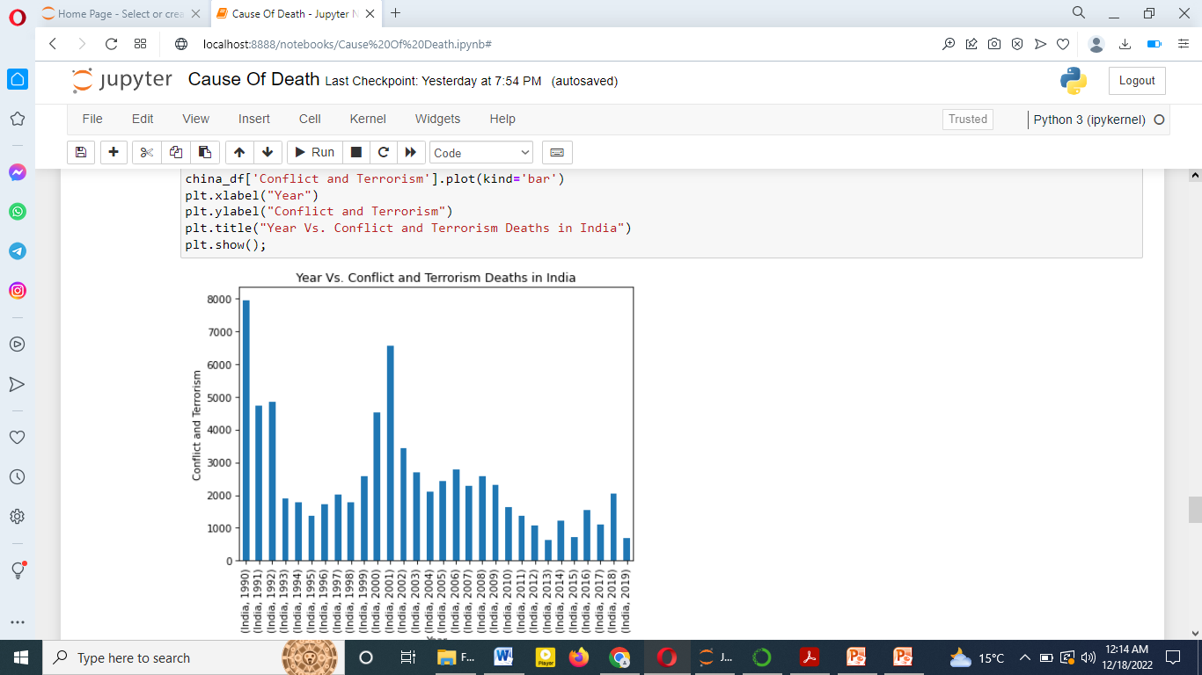

Slide 32
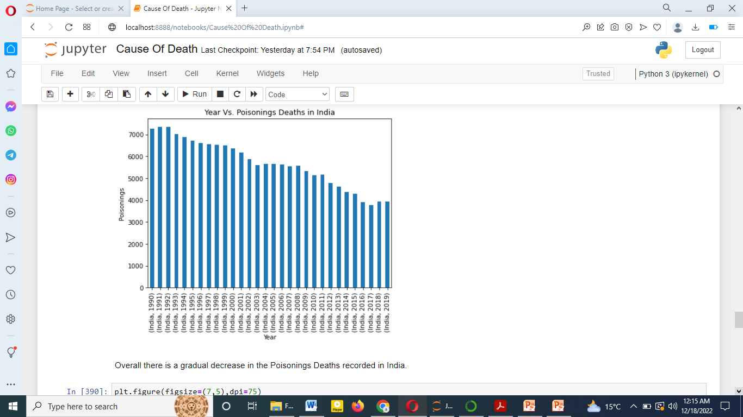

Slide 33


Slide 34


Slide 35
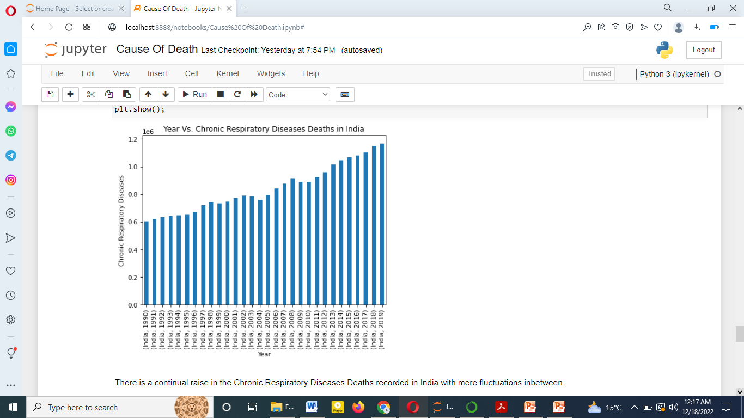

Slide 36
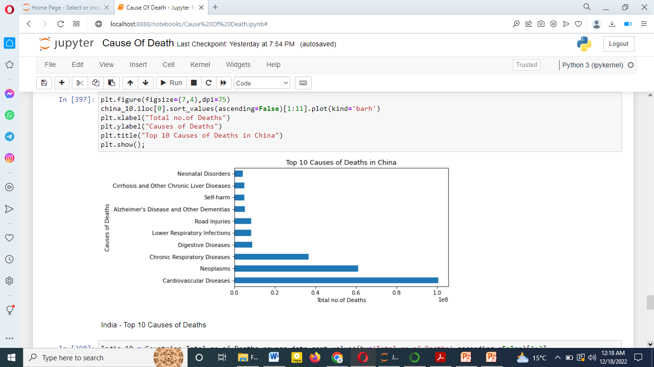

Slide 37
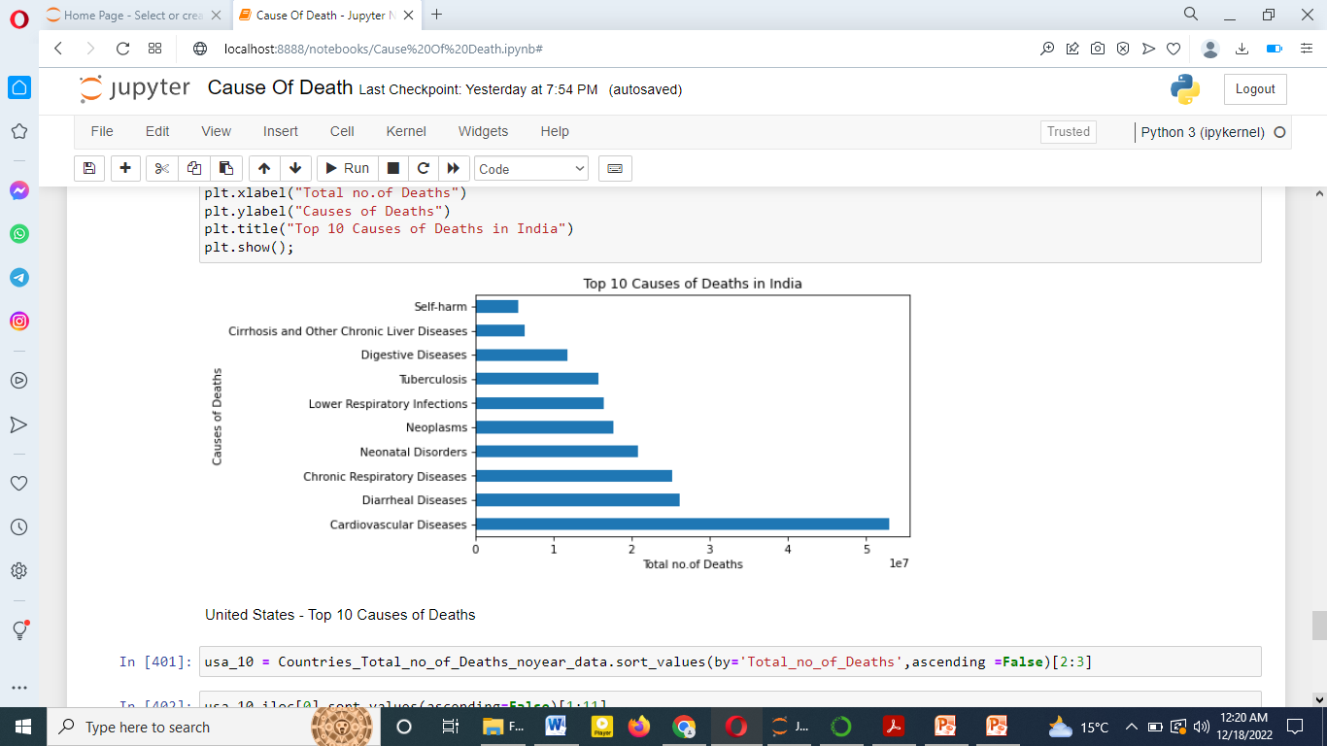

Slide 38
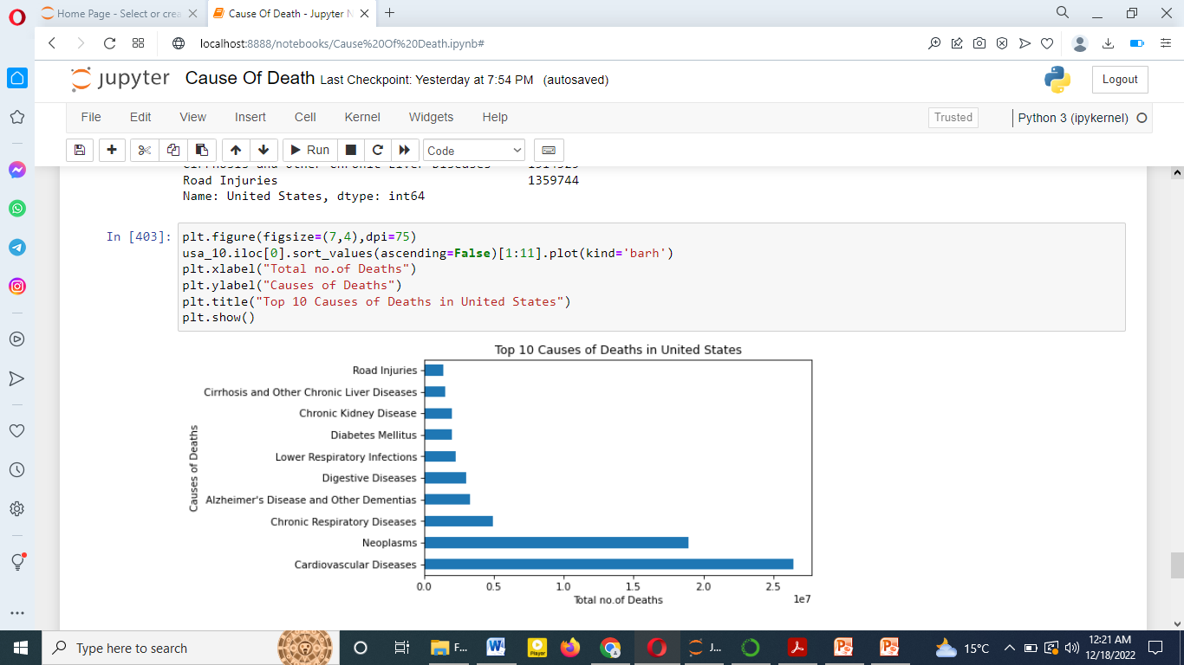

Slide 39
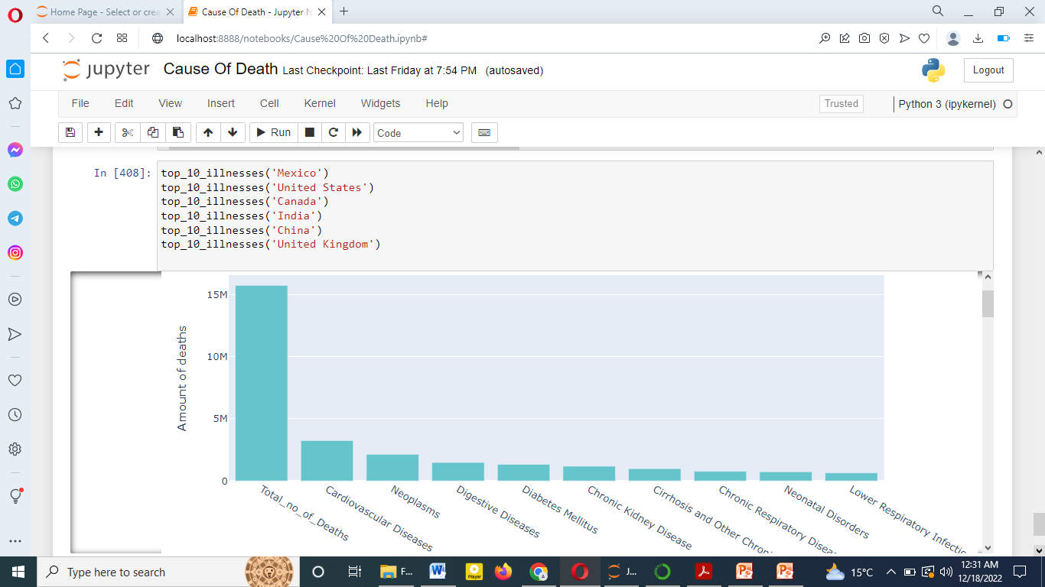

Slide 40
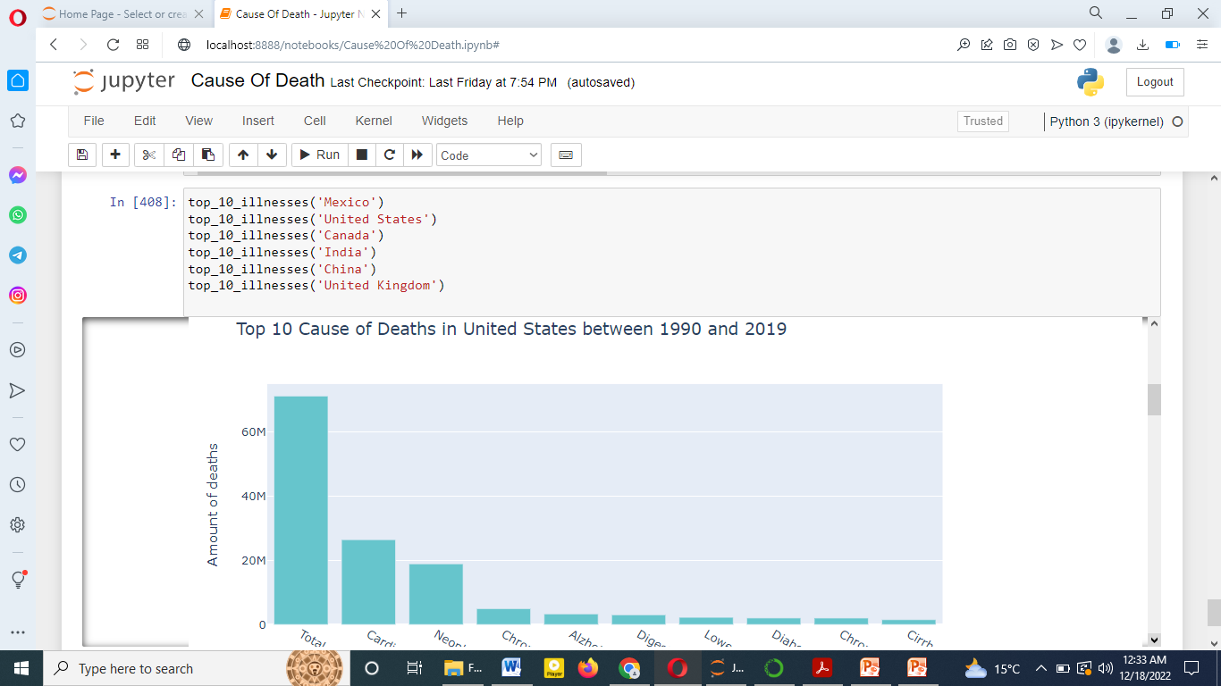

Slide 41
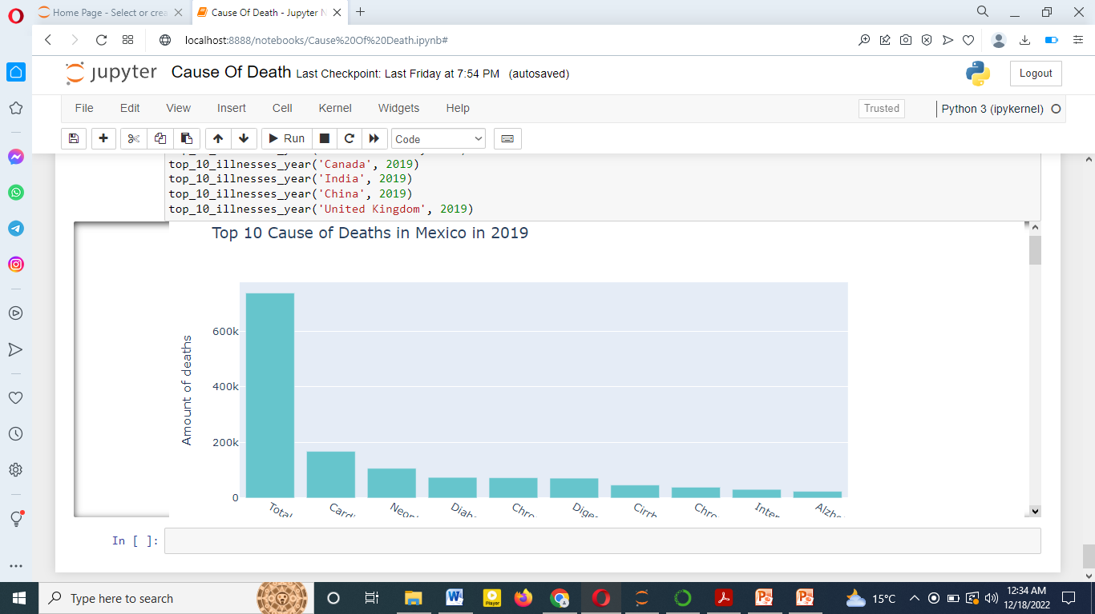

Slide 42
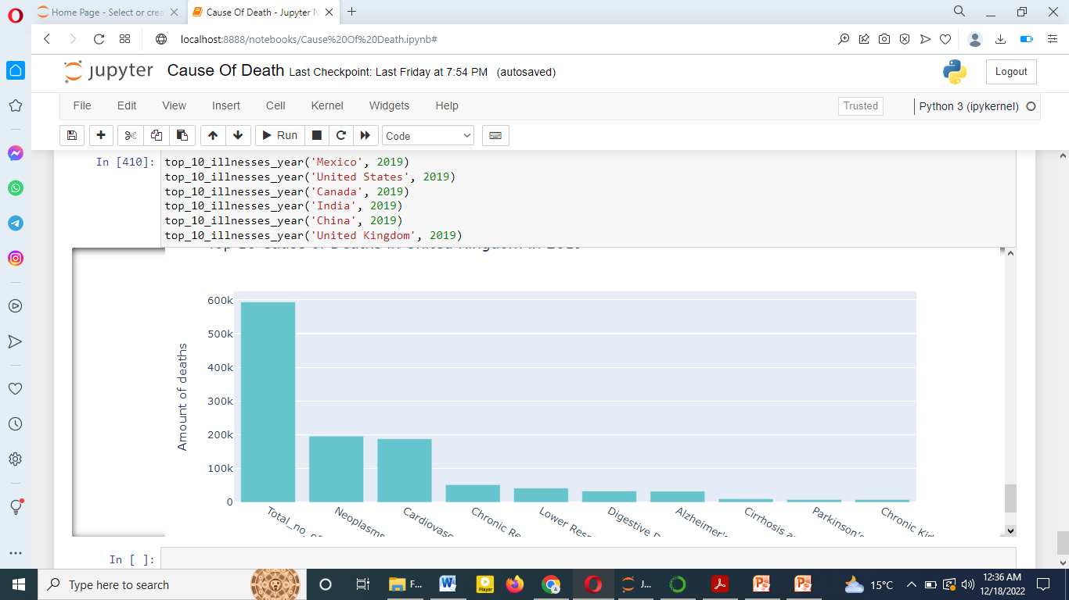

Slide 43
in top 50 china is top deaths in 1990 to 2020
In china data clear raise in Total No.of Deaths recorded with each year for China
In china rapid drop in Malaria Deaths recorded in China after 1999
There is a drop in Nutritional Deficiencies Deaths recorded in China in 2007 and from
2008 the count of deaths again started to raise
In china is a continual drop in Interpersonal Violence Deaths recorded in China
China is a continual drop in Maternal Disorder Deaths recorded in China after year 1998
Data set is a continual increase in HIV/AIDS Deaths recorded in China.
continual decrease in Tuberculosis Deaths recorded in China.
is a continual increase in Cardiovascular Diseases Deaths recorded in China.
continual drop in Self-harm Deaths recorded in China after year 2004
rapid raise in Exposure to Forces of Nature Deaths recorded in China in the year 2004
this is because of Sichuan earthquake of 2008
terrorist attack of 2014 is at Kunming Railway Station in Kunming, Yunnan, China on March 1st
continual raise in Poisonings Deaths recorded in China after year 1994.
continual raise in Protein-Energy Malnutrition Deaths recorded in China after year 2007.
continual drop in Road Injuries Deaths recorded in China after year 2009.
continual drop in Chronic Respiratory Diseases Deaths recorded in China after year 2004.
In india
death increase..
raise in Total No.of Deaths recorded with each year for India, even though there are
fluctuations inbetween

Slide 44
rapid drop in Malaria Deaths recorded in India from 1990, but the Deaths in 2018 and 2019 is greater than that of 2016 and 2017.
continual drop in Nutritional Deficiencies Deaths recorded in India from 1990.
raise in Interpersonal Violence Deaths recorded in India from 2014
continual drop in Maternal Disorders Deaths recorded in India after 1999
continual raise in HIV/AIDS Deaths recorded in India from 1992 and reached peak at 2006 from where there is continual drop
deviations in Tuberculosis Deaths recorded in India, there is a drop after year 1998
continual raise in Cardiovascular Diseases Deaths recorded in India
continual raise in Self-harm Deaths recorded in India from 1990 to 2001, but then there are fluctuations
Bhachau Taluka of Kutch (Gujarat) experienced an earthquake of 7.6 to 7.9 on the Richter Scale and lasted for 120 seconds. This disaster killed around 20,000, injured 167,000 and nearly 400,000 people became homeless.The 2013 incident: The year 2013 witnessed two major events, the Uttarakhand Flash Floods, mainly affecting the state of Uttarakhand and the Cyclone “Phailin” affecting two coastal states of Odisha and Andhra Prades
Overall there is a gradual decrease in the Poisonings Deaths recorded in India.
continual drop in the Protein-Energy Malnutrition Deaths recorded in India
continual raise in the Road Injuries Deaths recorded in India with fluctuations between 2013 to 2017
continual raise in the Chronic Respiratory Diseases Deaths recorded in India with mere fluctuations inbetween
Top 2 Cardiovascular diseases and diarrheal diseases in india

Slide 45
Cardiovascular diseases and neoplasms top 2 diseases united states
Top 10 cause of death in mexico between 1990 and 2019
1.Cardiavascular 2.neoplasms 3.digestive 4.diabetes5.chronic kidney6.cirrhosis 7chornic respiratory 8.neonatal Disorders 9. lower respiratory
Top 10 cause of death in united sates between 1990 and 2019
1.Cardiavascular 2.neoplasms 3.chornic respiratory .4.Alzheimer’s diseases5. Digestive diseases6. lower respiratory7.Diabetes mellitus 8.chronic kidney diseases9. cirrhosis and other chronic liver diseases
Top 10 cause of death in canada between 1990 and 2019
1.Cardiavascular 2.neoplasms 3.chornic respiratory .4.Alzheimer’s diseases5. Digestive diseases6. lower respiratory7.Diabetes mellitus 8.chronic kidney diseases9.self-harm
Top 10 cause of death in india between 1990 and 2019
1.Cardiavascular diseases2.Diarrheal diseases3.chronic Respiration diseases4.Neonatal Disorders 5.Neoplasms6.Lower Respiratiory infection 7.tuberculosis8.Digestive diseases9.cirrhosis and other chronic Liver diseases
Top 10 cause of death in china between 1990 and 2019
1.Cardiavascular 2.neoplasms 3.chornic respiratory 4.Digestive diseases 5. Lower Respiratiory infection 6.road injuries 7.Alzheimer’s diseases8. self-harm9.cirrhosis and other chronic Liver diseases
Top 10 cause of death in U.Kbetween 1990 and 2019
1.Cardiavascular 2.neoplasms 3.chornic respiratory4. lower respiratory5. Digestive diseases6.Alzheimer’s diseases and other Dementias 7. cirrhosis and other chronic liver diseases8. Diabetes mellitus 9.parkinson’s diseases

Slide 46
Cardiovascular diseases and neoplasms top 2 diseases united states
Top 10 cause of death in mexico between 1990 and 2019
1.Cardiavascular 2.neoplasms 3.digestive 4.diabetes5.chronic kidney6.cirrhosis 7chornic respiratory 8.neonatal Disorders 9. lower respiratory
Top 10 cause of death in united sates between 1990 and 2019
1.Cardiavascular 2.neoplasms 3.chornic respiratory .4.Alzheimer’s diseases5. Digestive diseases6. lower respiratory7.Diabetes mellitus 8.chronic kidney diseases9. cirrhosis and other chronic liver diseases
Top 10 cause of death in canada between 1990 and 2019
1.Cardiavascular 2.neoplasms 3.chornic respiratory .4.Alzheimer’s diseases5. Digestive diseases6. lower respiratory7.Diabetes mellitus 8.chronic kidney diseases9.self-harm
Top 10 cause of death in india between 1990 and 2019
1.Cardiavascular diseases2.Diarrheal diseases3.chronic Respiration diseases4.Neonatal Disorders 5.Neoplasms6.Lower Respiratiory infection 7.tuberculosis8.Digestive diseases9.cirrhosis and other chronic Liver diseases
Top 10 cause of death in china between 1990 and 2019
1.Cardiavascular 2.neoplasms 3.chornic respiratory 4.Digestive diseases 5. Lower Respiratiory infection 6.road injuries 7.Alzheimer’s diseases8. self-harm9.cirrhosis and other chronic Liver diseases
Top 10 cause of death in U.Kbetween 1990 and 2019
1.Cardiavascular 2.neoplasms 3.chornic respiratory4. lower respiratory5. Digestive diseases6.Alzheimer’s diseases and other Dementias 7. cirrhosis and other chronic liver diseases8. Diabetes mellitus 9.parkinson’s diseases

Slide 47
this is my conclusion of this dataset to need to decease the death of major resion of death in world and do the useful things to decrease diseases resion of death
THIS IS MY REPRESTATION OF THIS DATA SET
BY-NANDINI SINGH

